Slide 1
Computational Physics
2018/1/26
24F17017 Shohei Goda

Slide 2
I made my program with Runge-Kutta scheme

Slide 3
Cyclotron motion (2D) of electron and proton
$$r_{0}=\left(0.1,0,0\right), p_{0}=\left(0,0.1,0\right), B=\left(0,0,1\right), E=\left(0,0,0\right)$$

Slide 4
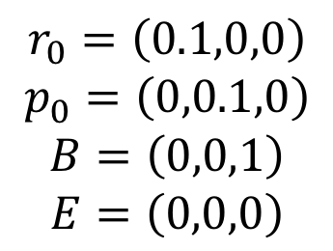
Cyclotron motion (2D) of electron and proton
$$r_{0}=\left(0.1,0,0\right)$$
$$p_{0}=\left(0,0.1,0\right)$$
$$B=\left(0,0,1\right)$$
$$E=\left(0,0,0\right)$$

Slide 5
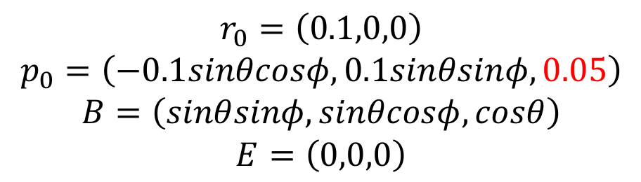
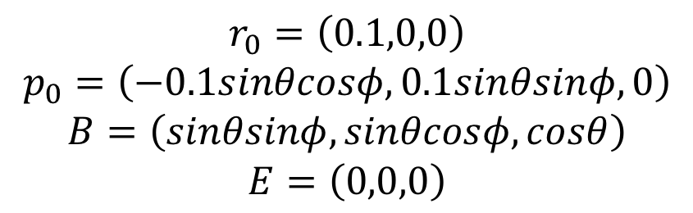
Cyclotron motion (3D) of electron
$$r_{0}=\left(0.1,0,0\right)$$
$$p_{0}=\left(−0.1sinθcosφ,0.1sinθsinφ,0\right)$$
$$B=\left(sinθsinφ,sinθcosφ,cosθ\right)$$
$$E=\left(0,0,0\right)$$
$$r_{0}=\left(0.1,0,0\right)$$
$$p_{0}=\left(−0.1sinθcosφ,0.1sinθsinφ,0.05\right)$$
$$B=\left(sinθsinφ,sinθcosφ,cosθ\right)$$
$$E=\left(0,0,0\right)$$

Slide 6
Linear acceleration by E-field
$$r_{0}=\left(0,0,0\right), p_{0}=\left(0,0,0\right), B=\left(0,0,0\right), E=\left(1,0,0\right)$$

Slide 7
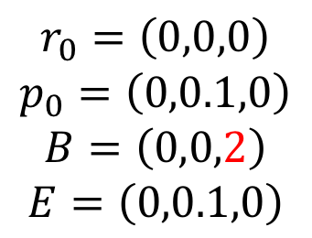
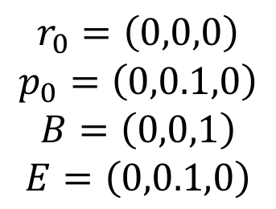
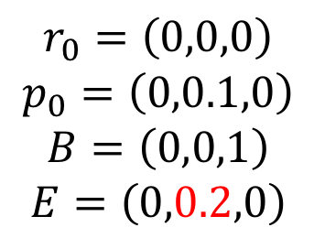
ExB drift
$$r_{0}=\left(0,0,0\right)$$
$$p_{0}=\left(0,0.1,0\right)$$
$$B=\left(0,0,1\right)$$
$$E=\left(0,0.1,0\right)$$
$$r_{0}=\left(0,0,0\right)$$
$$p_{0}=\left(0,0.1,0\right)$$
$$B=\left(0,0,1\right)$$
$$E=\left(0,0.2,0\right)$$
$$r_{0}=\left(0,0,0\right)$$
$$p_{0}=\left(0,0.1,0\right)$$
$$B=\left(0,0,2\right)$$
$$E=\left(0,0.1,0\right)$$

